Slide 1
Visualization Tool For Electric Vehicle Charge And Range Analysis
SlideMake.com

Slide 2
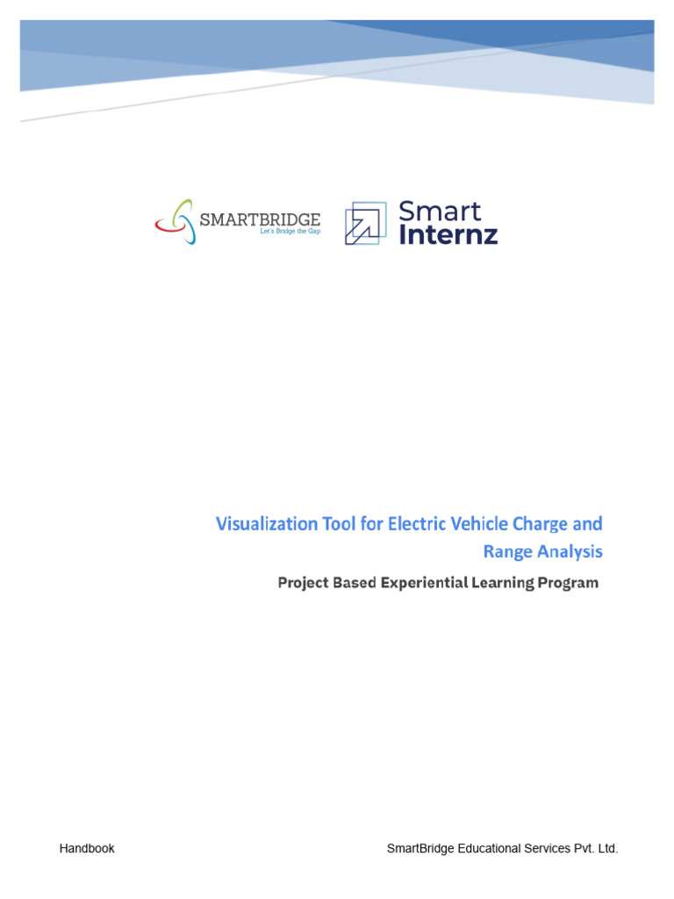
Introduction to EV Charge and Range Visualization
This presentation introduces a visualization tool designed for analyzing electric vehicle (EV) charge and range data.
Effective visualization helps users understand EV performance and optimize charging strategies.
The tool aims to support manufacturers, users, and policymakers in making data-driven decisions.
Notes:
Image source: https://imgv2-2-f.scribdassets.com

Slide 3

Importance of EV Range Analysis
Range analysis is crucial for assessing the real-world performance of electric vehicles.
It helps identify factors that influence driving range, such as speed, terrain, and weather.
Accurate range insights can improve user confidence and reduce range anxiety.
Notes:
Image source: https://opengraph.githubassets.com

Slide 4
Key Features of the Visualization Tool
The tool provides interactive dashboards for dynamic data exploration.
It supports various data inputs, including GPS, battery status, and environmental conditions.
Customizable charts and maps enable tailored insights for different user needs.
Notes:
Image source: https://opengraph.githubassets.com

Slide 5
Data Collection and Integration
Data is collected from vehicle telematics, charging stations, and user inputs.
Integration with existing EV management platforms allows seamless data flow.
Ensuring data accuracy and security is a priority for reliable analysis.
Notes:
Image source: https://opengraph.githubassets.com

Slide 6
Visualizing Charging Behavior
The tool displays charging sessions over time and location.
It highlights patterns such as frequent charging points and peak usage times.
Visualizations help optimize charging infrastructure placement and utilization.
Notes:
Image source: https://opengraph.githubassets.com

Slide 7
Range Prediction Modeling
Machine learning algorithms are employed to predict remaining range under various conditions.
Visual outputs include probability distributions and confidence intervals.
These predictions assist drivers in planning trips and charging stops effectively.
Notes:
Image source: https://opengraph.githubassets.com

Slide 8
Geographic and Temporal Analysis
Maps illustrate how range varies across different regions and routes.
Time-series charts show changes in battery health and performance over time.
Geographic insights support infrastructure planning and vehicle deployment strategies.
Notes:
Image source: https://opengraph.githubassets.com

Slide 9
User Interface and Experience
The visualization tool features an intuitive, user-friendly interface.
Interactive elements allow users to drill down into specific data points.
Clear visual cues aid in quick interpretation of complex data sets.
Notes:
Image source: https://opengraph.githubassets.com

Slide 10
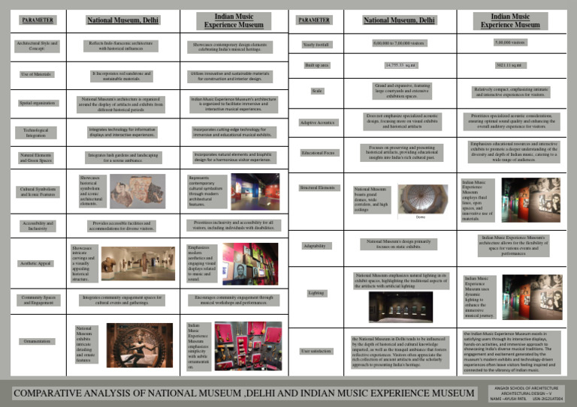
Case Studies and Applications
Case studies demonstrate improved route planning and reduced charging times.
Fleet managers utilize the tool to monitor vehicle performance across locations.
Policymakers leverage insights to support EV infrastructure development.
Notes:
Image source: https://imgv2-2-f.scribdassets.com

Slide 11
Future Developments and Conclusion
Future updates will incorporate real-time data and advanced analytics.
The visualization tool is a vital asset for enhancing EV efficiency and user experience.
Ongoing innovation aims to support the broader adoption of electric vehicles worldwide.
Notes:
Image source: https://opengraph.githubassets.com

